Slide 1
Are You Hungry? 你饿了吗？
John 6
约翰福音 6章

Slide 2
EVERYONE IS HUNGRY FOR SOMETHING
每一个人都会渴望着某样东西

Slide 3
John 6:1-2 1Some time after this, Jesus crossed to the far shore of the Sea of Galilee (that is, the Sea of Tiberias), 2 and a great crowd of people followed him because they saw the signs he had performed by healing the sick.
约翰福音 6:1-2
YOU ARE HUNGRY TO BE HEALED.
人渴望被医治。
这事以后，耶稣渡过加利利海，就是提比哩亚海。 2 有许多人因为看见他在病人身上所行的神迹，就跟随他。

Slide 4
人渴望食物---可以饱腹的食物
John 6:5-12 Jesus feeds 5000 with 5 loaves of bread & 2 Fish
5 When Jesus looked up and saw a great crowd coming toward him, he said to Philip, “Where shall we buy bread for these people to eat?”
7 Philip answered him, “It would take more than half a year’s wages to buy enough bread for each one to have a bite!”
YOU ARE HUNGRY FOR FOOD – PHYSICAL FOOD.
5 耶稣举目看见许多人来，就对腓力说：“我们从哪里买饼叫这些人吃呢？” 7 腓力回答说：“就是二十两银子的饼，叫他们各人吃一点也是不够的。”

Slide 5
耶稣要用他的方法来填满你的渴望
John 6:14-15
14 After the people saw the sign Jesus performed, they began to say, “Surely this is the Prophet who is to come into the world.” 15 Jesus, knowing that they intended to come and make him king by force, withdrew again to a mountain by himself.
JESUS WANTS TO FILL YOUR HUNGER THE WAY HE WANTS TO FILL IT.
14 众人看见耶稣所行的神迹，就说：“这真是那要到世间来的先知！”15 耶稣既知道众人要来强逼他做王，就独自又退到山上去了。

Slide 6
John 6:16-24 Jesus Walks on the Water
John 6:24 Once the crowd realized that neither Jesus nor his disciples were there, they got into the boats and went to Capernaum in search of Jesus.
24 众人见耶稣和门徒都不在那里，就上了船，往迦百农去找耶稣。

Slide 7
John 6:25-27
25 When they found him on the other side of the lake, they asked him, “Rabbi, when did you get here?” 26 Jesus answered, “Very truly I tell you, you are looking for me, not because you saw the signs I performed but because you ate the loaves and had your fill.
WHAT YOU ARE REALLY HUNGRY FOR IS … TO BE FULLY FILLED.
人真正渴望的是… 得到完全的满足
25 既在海那边找着了，就对他说：“拉比，是几时到这里来的？” 26 耶稣回答说：“我实实在在地告诉你们：你们找我，并不是因见了神迹，乃是因吃饼得饱。

Slide 8
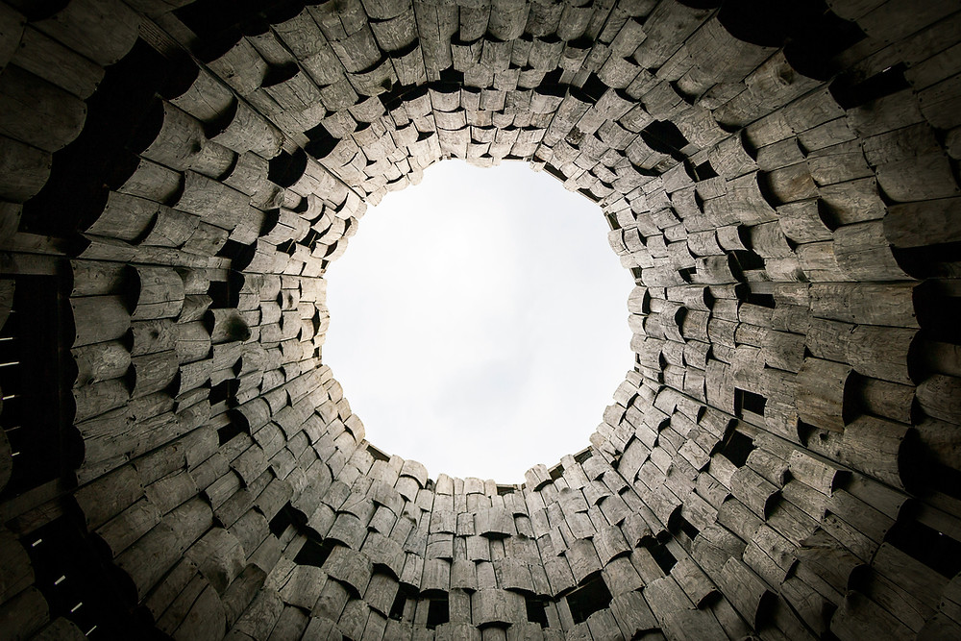
CISTERNS OF THE SOUL灵命的水池

Slide 9
John 6:27 Do not work for food that spoils, but for food that endures to eternal life, which the Son of Man will give you. For on him God the Father has placed his seal of approval.” 不要为那必坏的食物劳力，要为那存到永生的食物劳力，就是人子要赐给你们的，因为人子是父神所印证的。
2 TYPES OF HUNGER & 2 TYPES OF FOOD TO FILL THAT HUNGER
HUNGER 1 - EARTHYLY / PHYSICAL / TEMPORAL / IMMEDIATE
FOOD 1 – SPOILS / HAS AN EXPIRATION DATE / TEMPORAL
HUNGER 2 - GREATER / HEAVEN / ETERNAL
FOOD 2 – DOESN’T SPOIL / HAS NO EXPERIATION DATE / ETERNAL / JESUS
IF I WANT TO BE FULLY FILLED - SATISFIED – I NEED ETERNAL NOT TEMPORARY.
如果想要完全地被充满---得满足---需要的是永恒的满足而不是暂时的

Slide 10
2 JEWISH WRONG FOODS / 2 JESUS RIGHT FOODS
John 6:28-29 28 Then they asked him, “What must we do to do the works God requires?” 29 Jesus answered, “The work of God is this: to believe in the one he has sent.”28众人问他说：“我们当行什么，才算做神的工呢？”29 耶稣回答说：“信神所差来的，这就是做神的工。”
1st JEWISH WRONG FOOD – UNHEALTHY FOOD 犹太人错误的食物-不健康的食物
GOOD WORKS WILL FILL ME 做好事可以得满足
1ST JESUS RIGHT FOOD – HEALTHY FOOD 犹太人正确的食物—健康的食物
BELIEVE – TRUST IN JESUS’S WORKS ON YOUR BEHALF 相信 - 信靠耶稣为我们所做的工

Slide 11
IF I WANT TO BE FULLY FILLED – I NEED TO TRUST & BELIEVE IN JESUS’S WORKS MORE THAN MY WORKS.
要想完全的满足—
我需要信靠耶稣所做的工多过我自己的

Slide 12
John 6:31-33 31 Our ancestors ate the manna in the wilderness; as it is written: ‘He gave them bread from heaven to eat.’ 32 Jesus said to them, “Very truly I tell you, it is not Moses who has given you the bread from heaven, but it is my Father who gives you the true bread from heaven. 33 For the bread of God is the bread that comes down from heaven and gives life to the world.”
2ND JEWISH WRONG FOOD – UNHEALTHY FOOD
TRUST IN MOSES (6:32) – TRUST IN TEMPORAL PEOPLE 信靠摩西 –信靠可朽坏的人
2ND JESUS RIGHT FOOD – HEALTHY FOOD
TRUST IN YOUR HEAVENLY FATHER 信靠在天上的父
31 我们的祖宗在旷野吃过吗哪，如经上写着说：‘他从天上赐下粮来给他们吃。’” 32 耶稣说：“我实实在在地告诉你们：那从天上来的粮不是摩西赐给你们的，乃是我父将天上来的真粮赐给你们。 33 因为神的粮就是那从天上降下来赐生命给世界的。”

Slide 13
IF I WANT TO BE FULLY FILLED – I NEED TO TRUST IN MY HEAVENLY FATHER MORE THAN MAN.
要想完全得满足—
我需要信靠我的天父多过在地上的人

Slide 14
John 6:34-35 34 “Sir,” they said, “always give us this bread.” 35 Then Jesus declared, “I am the bread of life. Whoever comes to me will never go hungry, and whoever believes in me will never be thirsty.
34 他们说：“主啊，常将这粮赐给我们！” 35 耶稣说：“我就是生命的粮。到我这里来的，必定不饿；信我的，永远不渴。

Slide 16
John 6:34-35 34 “Sir,” they said, “always give us this bread.” 35 Then Jesus declared, “I am the bread of life. Whoever comes to me will never go hungry, and whoever believes in me will never be thirsty.
IF I WANT TO BE FULLY FILLED – I NEED THE BREAD OF LIFE – I NEED JESUS – I NEED GOD.
想要完全得满足 – 我需要生命的粮-我需要耶稣-我需要上帝
IF I WANT TO BE FILLED - SATISFY MY HUNGER, MY THIRST – FILL THAT EMPTINESS – I NEED JESUS. 想要完全得满足—满足我的饥渴-填满我的空虚-我需要耶稣
34 他们说：“主啊，常将这粮赐给我们！” 35 耶稣说：“我就是生命的粮。到我这里来的，必定不饿；信我的，永远不渴。

Slide 17
JOHN @ ATHENS SERVICE CENTER

Slide 18
PASTOR KIRT – I AM A CHRISTIAN & I BELIEVE IN JESUS. WHY AM I NOT FILLED SOME DAYS?
柯特牧师—我是一个基督徒，我也信靠耶稣。为什么有些时候我还是空虚？
YOU ARE FILLING YOUR PLATE WITH THE WRONG BREAD 你盘子里的食物不对
IF YOU WANT TO BE FILLED EVERYDAY OF YOUR LIFE ON EARTH & AFTER – FILL YOUR PLATE WITH THE BREAD OF LIFE – WITH JESUS.
如果你想让现在的和以后的日子都得到满足—就把生命的粮放着盘子上—就是耶稣

Slide 20
Are You Hungry?
John 6

Slide 21
EVERYONE IS HUNGRY FOR SOMETHING

Slide 22
John 6:1-2 1Some time after this, Jesus crossed to the far shore of the Sea of Galilee (that is, the Sea of Tiberias), 2 and a great crowd of people followed him because they saw the signs he had performed by healing the sick.
YOU ARE HUNGRY TO BE HEALED.

Slide 23
John 6:5-12 Jesus feeds 5000 with 5 loaves of bread & 2 Fish
5 When Jesus looked up and saw a great crowd coming toward him, he said to Philip, “Where shall we buy bread for these people to eat?”
7 Philip answered him, “It would take more than half a year’s wages to buy enough bread for each one to have a bite!”
YOU ARE HUNGRY FOR FOOD – PHYSICAL FOOD.

Slide 24
John 6:14-15
14 After the people saw the sign Jesus performed, they began to say, “Surely this is the Prophet who is to come into the world.” 15 Jesus, knowing that they intended to come and make him king by force, withdrew again to a mountain by himself.
JESUS WANTS TO FILL YOUR HUNGER THE WAY HE WANTS TO FILL IT.

Slide 25
John 6:16-24 Jesus Walks on the Water
John 6:24 Once the crowd realized that neither Jesus nor his disciples were there, they got into the boats and went to Capernaum in search of Jesus.

Slide 26
John 6:25-27
25 When they found him on the other side of the lake, they asked him, “Rabbi, when did you get here?” 26 Jesus answered, “Very truly I tell you, you are looking for me, not because you saw the signs I performed but because you ate the loaves and had your fill.
WHAT YOU ARE REALLY HUNGRY FOR IS … TO BE FULLY FILLED.

Slide 27
CISTERNS OF THE SOUL

Slide 28
John 6:27 Do not work for food that spoils, but for food that endures to eternal life, which the Son of Man will give you. For on him God the Father has placed his seal of approval.”
2 TYPES OF HUNGER & 2 TYPES OF FOOD TO FILL THAT HUNGER
HUNGER 1 - EARTHYLY / PHYSICAL / TEMPORAL / IMMEDIATE
FOOD 1 – SPOILS / HAS AN EXPIRATION DATE / TEMPORAL
HUNGER 2 - GREATER / HEAVEN / ETERNAL
FOOD 2 – DOESN’T SPOIL / HAS NO EXPERIATION DATE / ETERNAL / JESUS
IF I WANT TO BE FULLY FILLED - SATISFIED – I NEED ETERNAL NOT TEMPORARY.

Slide 29
2 JEWISH WRONG FOODS / 2 JESUS RIGHT FOODS
John 6:28-29 28 Then they asked him, “What must we do to do the works God requires?” 29 Jesus answered, “The work of God is this: to believe in the one he has sent.”
1st JEWISH WRONG FOOD – UNHEALTHY FOOD
GOOD WORKS WILL FILL ME
1ST JESUS RIGHT FOOD – HEALTHY FOOD
BELIEVE – TRUST IN JESUS’S WORKS ON YOUR BEHALF

Slide 30
IF I WANT TO BE FULLY FILLED – I NEED TO TRUST & BELIEVE IN JESUS’S WORKS MORE THAN MY WORKS.

Slide 31
John 6:31-33 31 Our ancestors ate the manna in the wilderness; as it is written: ‘He gave them bread from heaven to eat.’ 32 Jesus said to them, “Very truly I tell you, it is not Moses who has given you the bread from heaven, but it is my Father who gives you the true bread from heaven. 33 For the bread of God is the bread that comes down from heaven and gives life to the world.”
2ND JEWISH WRONG FOOD – UNHEALTHY FOOD
TRUST IN MOSES (6:32) – TRUST IN TEMPORAL PEOPLE
2ND JESUS RIGHT FOOD – HEALTHY FOOD
TRUST IN YOUR HEAVENLY FATHER

Slide 32
IF I WANT TO BE FULLY FILLED – I NEED TO TRUST IN MY HEAVENLY FATHER MORE THAN MAN.

Slide 33
John 6:34-35 34 “Sir,” they said, “always give us this bread.” 35 Then Jesus declared, “I am the bread of life. Whoever comes to me will never go hungry, and whoever believes in me will never be thirsty.

Slide 35
John 6:34-35 34 “Sir,” they said, “always give us this bread.” 35 Then Jesus declared, “I am the bread of life. Whoever comes to me will never go hungry, and whoever believes in me will never be thirsty.
IF I WANT TO BE FULLY FILLED – I NEED THE BREAD OF LIFE – I NEED JESUS – I NEED GOD.
IF I WANT TO BE FILLED - SATISFY MY HUNGER, MY THIRST – FILL THAT EMPTINESS – I NEED JESUS.

Slide 36
JOHN @ ATHENS SERVICE CENTER

Slide 37
PASTOR KIRT – I AM A CHRISTIAN & I BELIEVE IN JESUS. WHY AM I NOT FILLED SOME DAYS?
YOU ARE FILLING YOUR PLATE WITH THE WRONG BREAD
IF YOU WANT TO BE FILLED EVERYDAY OF YOUR LIFE ON EARTH & AFTER – FILL YOUR PLATE WITH THE BREAD OF LIFE – WITH JESUS.

